Slide 1

Hospital Patient Flow and Time Optimization: A Data-Driven Study mysql project created by sayan mukherjee

Slide 2
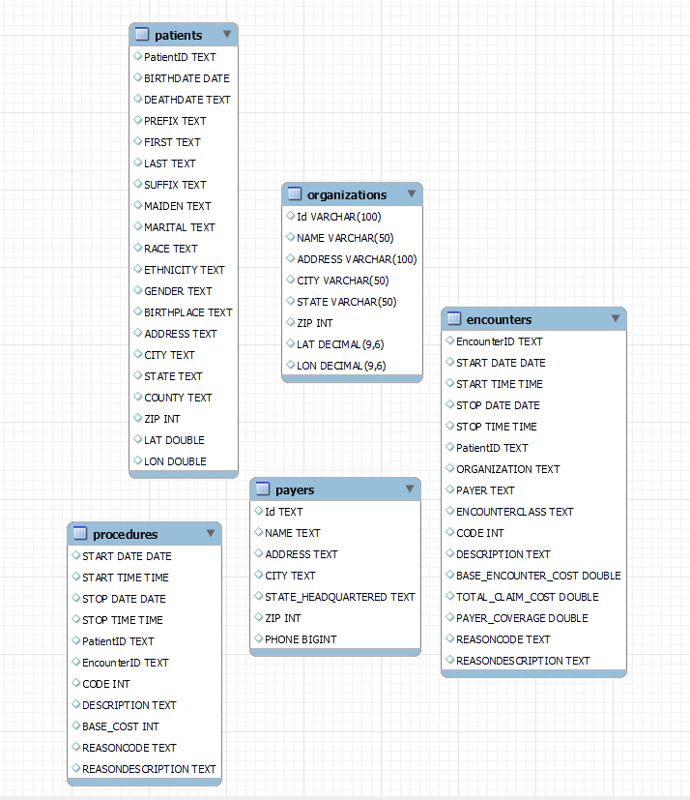
Introduction:
This project analyzes hospital data of encounters, patients, procedures, payers, and organizations to get an insight on patient flow, repeat visits and trends in encounter times to influence hospital operations.

Slide 3

Overview:
This project studies hospital data to analyze patient visit patterns, repeat encounters, encounter and procedure time duration..

Slide 4

Objective:
Improve patient flow and decrease hospital crowding

Slide 5
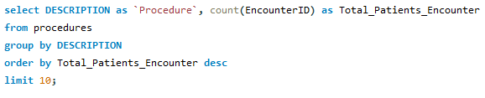
1. Which Procedures Account for the Highest Number of Patient Encounters?
Insight:
In the analysis, it is revealed that most patient encounters involve assessment-based and screening procedures. The procedure with the highest number of encounters is Assessment of health and social care needs (4,596).

Slide 6
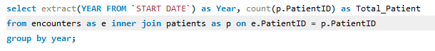
2. Which time periods (year) experience peak patient volume?
The analysis shows two years with notably higher patient volumes. The highest number of patients was recorded in 2014 (3,885 patients), followed by 2021 (3,530 patients).
The remaining years show moderate and consistent patient volumes, indicating steady hospital utilization over time. In contrast, patient volume dropped sharply to 220 in 2022, representing a significant decline compared to previous years.
Insight:

Slide 7
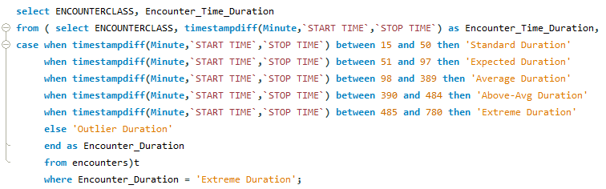
3. Which encounters show extreme durations(minutes).
ENCOUNTERCLASS | Encounter Time Duration (Minutes)
ambulatory | 660
emergency | 780
Insight:
The analysis of encounter durations reveals that extreme time durations occur in the ambulatory and emergency encounter classes. Among these, emergency encounters have the longest duration (780 minutes), followed by ambulatory encounters (660 minutes).

Slide 8
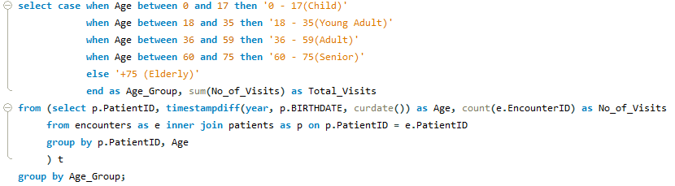
4. are certain age groups more likely to have frequent visits
Insight:
The analysis shows that patients aged 75 and above have the highest frequency of visits, while the 18 –35 age group has the lowest number of visits, indicating that older patients contribute most to hospital utilization.

Slide 9
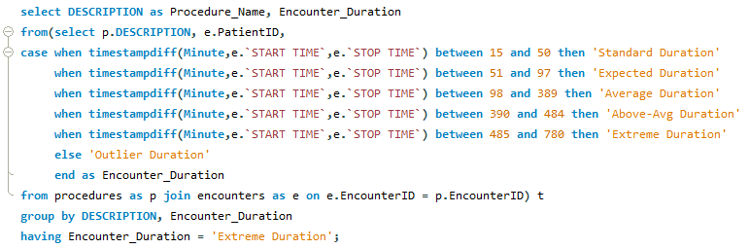
5. Which Procedure are associated with extreme encounter duration?
Procedure_Name
Resuscitation using intravenous fluid (procedure)
Admit to ICU (procedure)
Transfer to stepdown unit (procedure)
Insight:
The results reveal that the longest emergency room encounter durations are associated with three procedures: resuscitation using intravenous fluid, admission to the ICU, and transfer to a step-down unit.

Slide 10
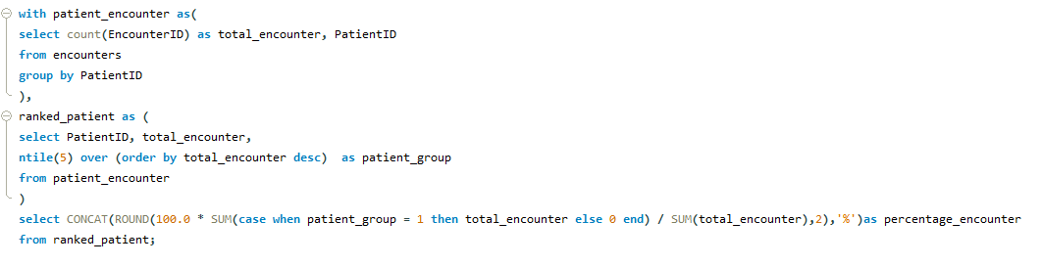
6. What Percentage of encounter come from the top 20% of Patients
Encounter Percentage
67.83%
Insight:
The analysis reveals that the top 20% of patients account for 67.83% of total encounters.

Slide 11
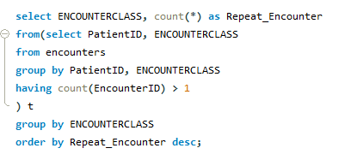
7. Which encounter class contributes most to repeat patient visits?
Insight:
The analysis shows that ambulatory and outpatient encounter classes contribute the most to repeat patient visits. Among these, ambulatory encounters have the highest number of repeat visits (660), followed by outpatient encounters (576).

Slide 12
Recommendations:
Establish specialized care plans and structured post-discharge programs for patients aged 75+, as they account for the highest number of hospital visits.
Increase staffing levels and allocate additional resources to emergency and outpatient encounters, as these currently experience the longest durations.
Implement process optimization strategies to reduce encounter and procedure durations, enabling smoother patient flow and improved operational efficiency.
Strengthen coordination for ICU admissions and step-down transfers, as these procedures are associated with extremely long encounter durations.

